Slide 1

MACHINE LEARNING report
DIABETES DATASET

Slide 2
Key Points of Predictive Analysis
Diabetes dataset has been taken to analyse that which person has diabetes and which doesn’t.
All features of the dataset has been considered for the prediction.
The predictive or dependent feature ‘Class’ has been converted to 0 or 1 in the start for ease of understanding and use.

Slide 3
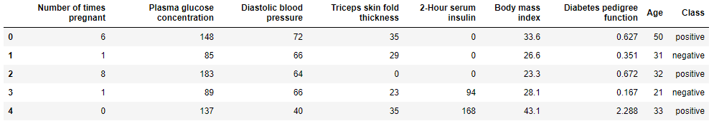
Diabetes Dataset
The dataset consists of 9 columns and rest statistics have been explained in the python notebook.

Slide 4
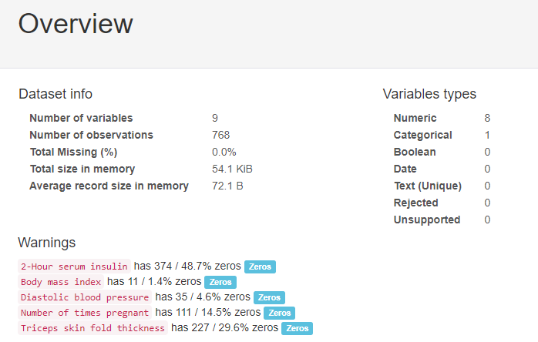
Pre-Profiling Report
The dataset consists of 9 columns and rest statistics have been explained in the python notebook.

Slide 5
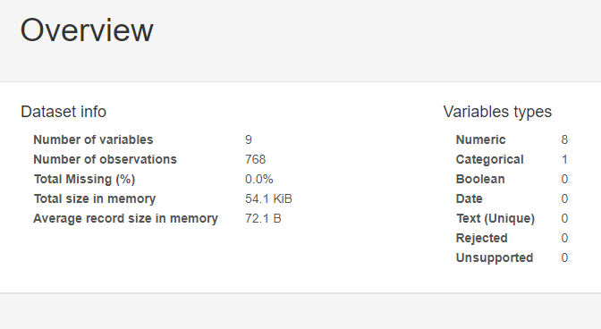
Post-Profiling Report
This is the processing report after cleaning and processing the data.

Slide 6
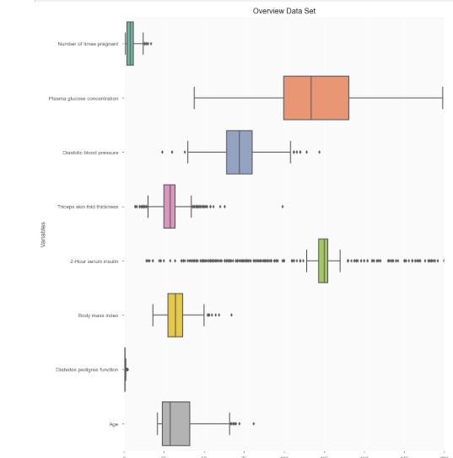
Overview of Data
This is a boxplot representation of the Overview of data.

Slide 7
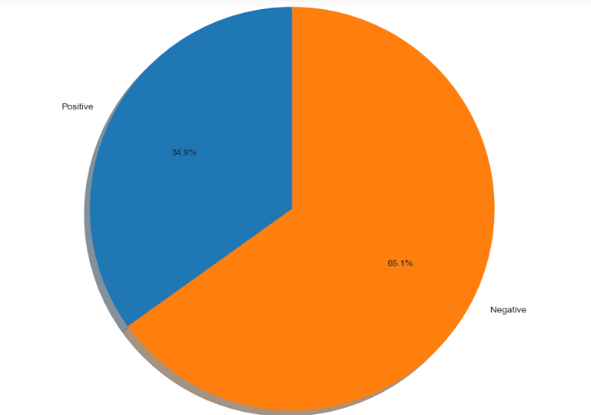
Representing labels
This is a pie chart representation of the Positive(Diabetic) and Negative(Non-Diabetic) label data.

Slide 8
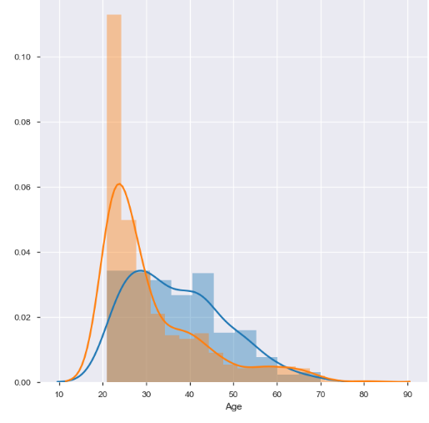
‘Age’ feature vs. ‘Class’
This is a representation of the ‘Age’ feature vs. the ‘Class’ labels, Positive(Diabetic) and Negative(Non-Diabetic) label data.

Slide 9
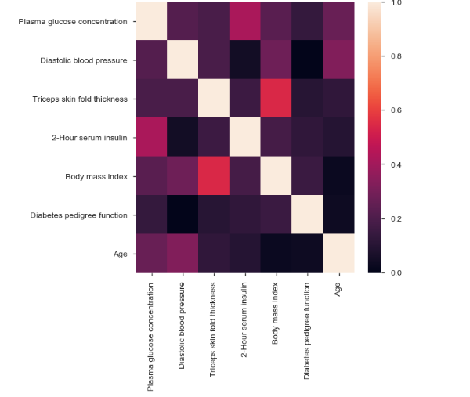
Feature representation
This is a representation of the correlation between all the features of the data..

Slide 10
ML Models & Algorithms Used
Preparing and Splitting of data using Pandas.
Logistic Regression without GridSearchCV.
Logistic Regression with GridSearchCV.
Decision Tree Classifier.
Random Forest Classifier.

Slide 11
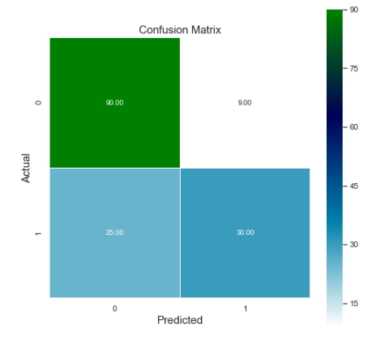
Logistic Regression without using GridSearchCV – Confusion Matrix
In confusion matrix created by using Logistic regression without using GridSearchCV,
The accuracy score of the test data is 77.92%.

Slide 12
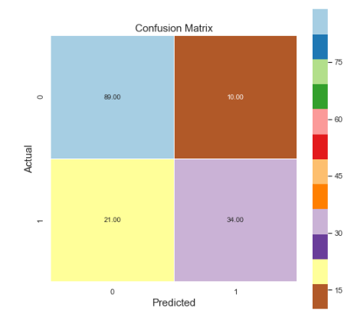
Logistic Regression with using GridSearchCV
In confusion matrix created by using Logistic regression with using GridSearchCV,
The accuracy score of the test data is 79.87%.

Slide 13
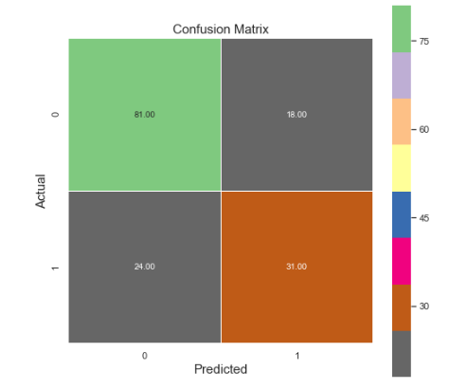
Decision Tree Classifier
In confusion matrix created by Decision Tree Classifier, the accuracy score of the test data is 72.72%.

Slide 14
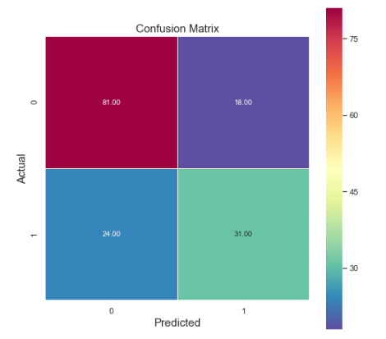
Random Forest Classifier
In confusion matrix created by Random Forest Classifier, the accuracy score of the test data is 78.57%.

Slide 15
This machine learning project has made me learn:
This project has helped me to apply various Machine Learning models and algorithms.
2. From this, I have learnt which model is most appropriate in accordance to my dataset.
3. The predicted values has been compared with the actual values, and has reported an accuracy of approximately 80%.
4. The conclusions derived from EDA are as follows:
The percentage of positive(Diabetic) records is 34.9%
The percentage of negative(Non-diabetic) records is 65.1%
5. The ‘Age’ with the most Diabetic or positive label is >30 years.

Slide 16

Thank You and Have a Good Day !

